Slide 1

Cybersecurity Fundamentals Project
( Dos and DDos Attacks )
|
Instructor: Prof. Fatemah Alharbi
1

Slide 2

Definitions of DoS and DDoS Attacks :
• Denial of Service (DoS):
These attacks aim to prevent legitimate users from accessing a specific resource by overwhelming it.
• Distributed Denial of Service (DDoS):
A large-scale attack using compromised devices (botnets) to generate massive traffic, disrupting services.
2

Slide 3
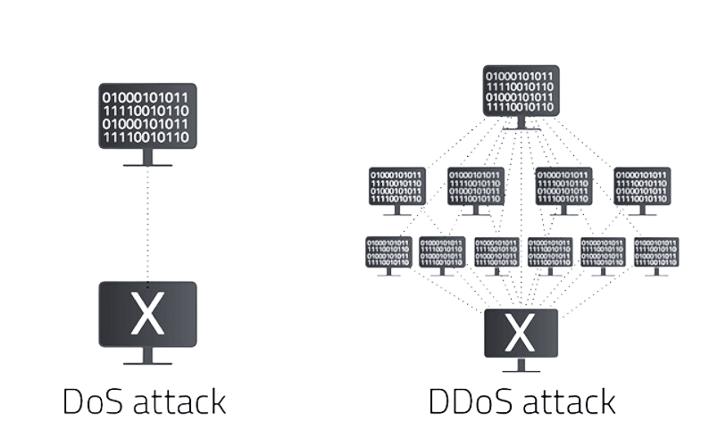
Difference Between DoS and DDoS Attacks:
3

Slide 4
Attack targets:
Application resources:
System resources:
Network bandwidth:
target the overall server capabilities (CPU, RAM).
targets the network connection to cause congestion and disrupt data flow.
target the application itself (e.g., databases).
Overwhelming the application (e.g., web server) with complex requests, consuming CPU and memory.
Example: HTTP Flood attack, where numerous requests overload the server's resources.
Overloading the server's overall resources (CPU, RAM) to cause crashes or slowdowns.
Example: A flood of requests that exhausts CPU and memory, causing the server to become unresponsive.
Flooding the network with excessive traffic, consuming all bandwidth and causing congestion.
Example: UDP Flood or SYN Flood, where massive amounts of data overwhelm the network, preventing legitimate access.
4

Slide 5

Detection and Mitigation Methods :
Statistical Analysis:
AI Tools:
Monitors traffic for abnormal patterns.
Uses machine learning to detect attacks.
Knowledge-Based Methods:
Data Mining:
Matches traffic against known attack behaviors.
Groups and analyzes traffic to identify suspicious activity.
5

Slide 6
Countermeasures: Defense Strategies
1. Source-End Defense:
Mitigates attack traffic close to its source.
2. Victim-End Defense:
Protects the targeted system or service.
3. Core-End Defense:
Filters attack traffic at intermediate routers.
4. Hybrid Defense:
Combines all above approaches for maximum protection.
6

Slide 7
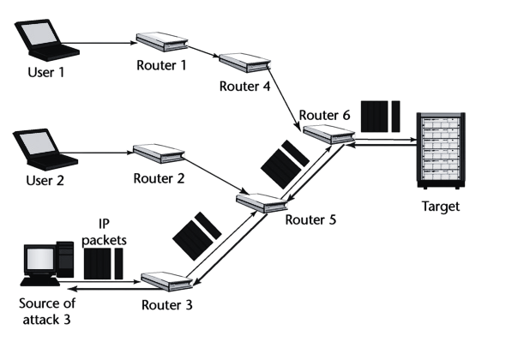
Traceback Mechanisms :
1. Packet Marking:
Routers embed path information in packets to trace attacks.
2. Packet Logging:
Routers store packet details for later analysis.
3. Honeypots:
Fake systems attract attackers, aiding in source identification.
4. Entropy Analysis:
Monitors randomness in traffic to locate attacks.
7

Slide 8
Statistics on DoS and DDoS Attacks
1. Increase in Attacks:
DDoS attacks have become more frequent and complex.
2. Attack Sizes:
• Amazon (2020): Eight-hour attack disrupted AWS services.
• GitHub (2018): Attack peaked at 1.35 terabits per second.
3. Impact on Businesses:
Service outages and financial losses.
4. Costs:
Losses can reach millions of dollars per attack.
8

Slide 9
Mairi Botnes Attack (2016)
In 2016, the Mairi Botnes attack became one of the most impactful cyberattacks,causing significant disruptions across various online services.
Target: The attack primarily targeted Dyn DNS servers,by disrupting this critical infrastructure, the attackers affected major platforms such as Twitter, Netflix, and GitHub.
Attack Type: A large-scale DDoS attack using a botnet of compromised loT devices (e.g., cameras and routers) to flood the servers with traffic
Protocols: The attack targeted DNS and HTTP/HTTPS protocols, crippling DNS resolution and overloading web servers.
Execution: The attackers used the Mirai botnet to direct thousands of compromised IoT devices to send massive DNS requests to Dyn, causing service failures.
9

Slide 10
Countermeasures After the Mairi Botnes Attack (2016) :
In response to the Mairi Botnes attack, several measures were implemented to mitigate future DDoS risks:
Enhanced DNS Redundancy: DNS servers were distributed across multiple data centers to reduce single points of failure and improve system reliability.
Improved IoT Security Practices: Stronger passwords, better default settings, and enhanced authentication methods were enforced to reduce loT device vulnerabilities and limit their use in botnets.
Rate Limiting and Traffic Filtering: Advanced techniques were adopted to detect and block abnormal traffic patterns, such as excessive DNS or HTTP requests.
Regular IoT Device Updates: Ensuring lot devices received regular firmware updates and security patches became a priority to prevent exploitation.
10

Slide 11
Simple Tips to Stay Safe from DoS/DDoS Attacks :
1. Use strong passwords:
Make them unique and complex.
2. Update your devices regularly:
To fix security vulnerabilities.
3. Disable unnecessary services:
To reduce exposure to attacks.
4. Install reliable security software:
To protect against malware.
11

Slide 12
Simple Tips to Stay Safe from DoS/DDoS Attacks(2) :
5. Avoid suspicious links:
To prevent unauthorized access.
6. Secure your router:
Change default settings and enable encryption.
7. Enable two-factor authentication:
For added account security.
8. Monitor network activity:
Check for unusual slowdowns.
12

Slide 13
References :
1-
2-
3-
Radware Captcha Page
DoS Attack vs. DDoS Attack: Key Differences (Fortinet)
Understanding the Difference between DoS and DDoS Attacks
13

